Slide 1
Aggie Hacks x Google cloud
Tackling HEALTHCARE Access With telehealth

Slide 2




OUR TEAM : Cloudwalkers
Jonathan Vareika
Bokun Chen
Yuntong
Xiao
Ethan
Meng

Slide 3
TABLE OF CONTENTS
01
Objective
02
Identifying the problem
03
Our solution
04
Recommendation and Impact
Problem statement on healthcare access disparities
Some subgroups are more vulnerable in lacking proper access to healthcare
How the problem can be solved using telehealth
Recommendation to better adopt telehealth into the care system. And the estimated impact of our recommendations

Slide 4
Objective

Slide 5
Background
The problem
Our Goal
Healthcare access disparities have seen a notable drop in the last decade thanks to the implementation of policies and legislation but progress has stalled in the past few years.
Systemic inequalities in healthcare access persist within social, racial and geographical groups and Covid-19 has in some cases worsened the situation, notably when it comes to access.
In response to the health crisis, telehealth has seen a massive increase of adoption to improve access to care, reduce disease exposure and decrease patient demand on facilities.
We aim to identify how telehealth improves healthcare quality and access, which social, racial and geographical groups benefit the most from that service, and build a case in favor of telehealth post pandemic.
Notes:
Healthcare access disparities have long been at the center stage of America. They have been mitigated by past policies and legislation but have seen a stale progress in the past few years.
Systemic inequalities persist within social, racial and geographical groups and Covid-19 has in some cases worsened the situation.
In response to the health crisis, telehealth has seen a massive increase of adoption to improve access to care, reduce disease exposure and decrease patient demand on facilities.
This expansion might be short lived as health insurer including medicare might roll back converge and other policies for remote health services.
We aim to identify the groups lacking access to healthcare and see if telehealth can reduce disparities amongst those groups to build a case in favor of telehealth post pandemic.

Slide 6
Data Source
Reliability
Continuity
Coverage
Primary data sources:
National Health Interview Survey (NHIS), cdc.gov
Household Pulse Survey (Covering health care access, telemedicine, and mental health topic), U.S. Census Bureau
CDC and U.S Census Bureau have developed information quality guidelines to maintain the high quality of public data and information
Our Data sets have years before COVID and continued data during the pandemic
Dataset covers different Races, Age, Sex, Insured or not, and Regions
Notes:
The data source is primarily from the Centers for Disease Control and Prevention focused on healthcare access disparities and telehealth usage before and during the pandemic.
The National Health Interview Survey (NHIS) has monitored the health of the nation since 1957. NHIS data on a broad range of health topics are collected through personal household interviews.
The Household Pulse Survey (Covering health care access, telemedicine, and mental health topics) by CHS & U.S. Census Bureau provides relevant information about the scope of the impact of COVID-19 in the United States.
Are data sources are reliable as the CDC and U.S Census Bureau have developed information quality guidelines to maintain the high quality of public data and information. We also have continuous data from before and during the pandemic, covering differents groups such as races, age, sex, insured or not annd regions.

Slide 7
Identifying the problem
Notes:
Firstly, we uses descriptive analysis to identify the current situation in terms of disparity in health inequality in several aspect, especially in terms of access to healthcare.

Slide 8
Health inequality
HealtHcare Access
Avoidable differences in healthcare within different groups of individuals due to unfair systems impacting living conditions and access to healthcare.
“The timely use of personal health services to achieve the best health outcome” - Institute of Medicine
Healthcare access consists of four components:
Coverage Service
Timeliness Workforce
Notes:
Lets first define some terms.
Health inequality can be defined as the avoidable differences in health within different groups of individuals due to unfair systems impacting living conditions and access to healthcare. Those who experience greater health burdens usually have less health care resources.
Now talking about healthcare access.
The Institute of Medicine (IOM) defines healthcare access as “The timely use of personal health services to achieve the best health outcome”. It consists of four main components:
Coverage: Insured individual are more likely to receive proper medical care as insurance facilitate entry into the healthcare system.
Service: Recommended screening and prevention services are associated with usual source of care
Timeliness: Receiving healthcare when need is recognized
Workforce: competent and qualified providers
Those components are not always respected and health inequalities still persist, meaning those who experience greater health brudens have, in fact, less healthcare access.

Slide 9
Lack of Access to Healthcare due to inequalities
Income
Coverage
Location
Low income and high cost associated with health services
Lack of access to basic health insurance coverage
Lack of quality care due to geographic location
Notes:
The lack of access to healthcare can occur because of multiple reasons.
Lower income and high costs associated with health services is the primary factor for not seeking professional care when needed.
Lack of access to basic insurance coverage also constitute a major factor hindering proper access to healthcare services. National Institutes of Health estimates 30 million people in the United States still lack access to basic health insurance coverage.
Lack of quality healthcare and lack of access to health specialists can occur because of geographic location.
These are not the only factors creating differences in access to healthcare, we can think of differences in language spoken and disability status also as barriers to proper access to healthcare.

Slide 10
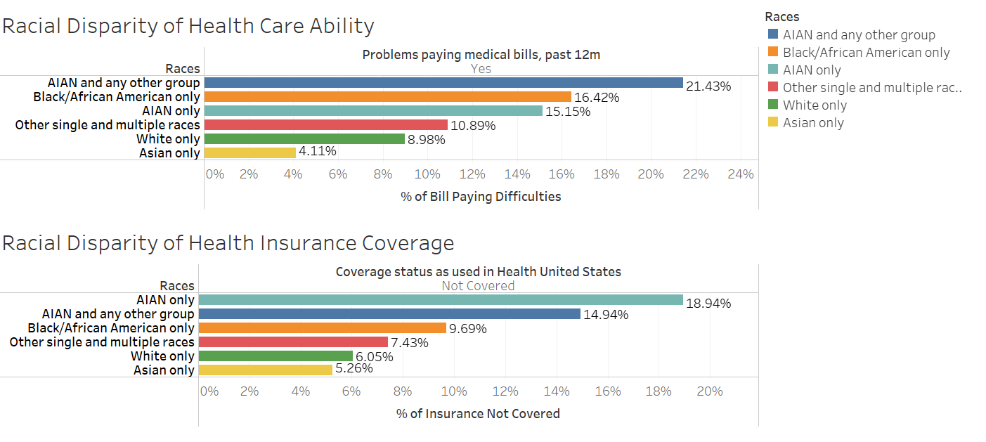
Problem: Disparity Among Races in Affordability and coverage
Notes:
There still exists a wide disparity amongst race when it comes to health affordability and coverage.
Affordability is measured by the ability to pay medical bills on time. We observe a clear distinction with american indian and alaskan native as well as african american having highest percentage in problems paying medical bills past 12 months.
Coverage is as well very unequally distributed woot he same groups being over-represented when it comes to uninsured groups.

Slide 11
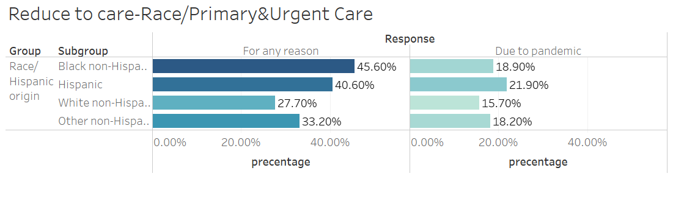
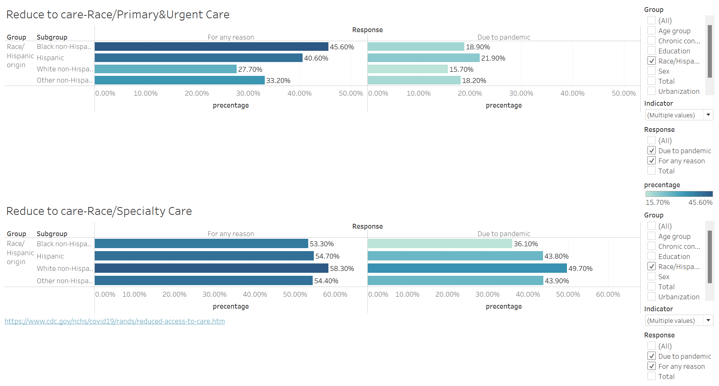
Problem: Disparity Among Races in reduced care during the pandemic
Reduce to care in primary and urgent care is calculated on not getting medical care due to cancelled appointments, cutback in transportation options and fear of going to the emergency room due to the pandemic
Notes:
As a result of the coronavirus pandemic, people also may not get needed medical care due to cancelled appointments, cutbacks in transportation options, fear of going to the emergency room due to the pandemic.
We observe reduce to care has unequally impacted black and hispanic groups compared to other groups.
Estimates on this page are derived from the Household Pulse Survey and show the percentage of U.S. adults who delayed getting medical care in the last four weeks or who needed medical care at any time in the last four weeks for something other than coronavirus but did not get it because of the coronavirus pandemic.

Slide 12
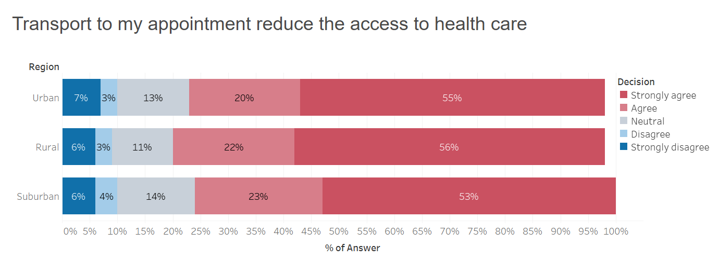
Problem: Disparity in Urban VS rural area in accessibility
Transport to appointment to access healthcare is more strongly affecting individuals in rural areas.
Rural areas also have on average less access to specialist with 30 specialists per 100,000 residents compared to urban areas that count 263 specialists per 100,000 residents.
Notes:
Distance and transportation are major reason for access health care reduce in rural area.
Transport to appointment to access healthcare is more strongly affecting individuals in rural areas. Rural areas also have on average less access to specialist with 30 specialists per 100,000 residents compared to urban areas that count 263 specialists per 100,000 residents

Slide 13
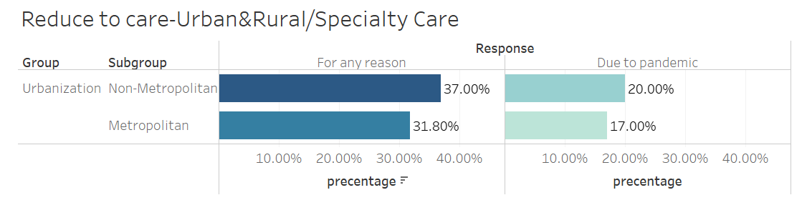
Problem: Disparity in Urban VS rural area during the pandemic
Reduce to care in Specialty Care is calculated on not getting medical care due to cancelled appointments, cutback in transportation options and fear of going to the emergency room due to the pandemic.
Notes:
As a result of the coronavirus pandemic, people also may not get specialty care due to cancelled appointments, cutbacks in transportation options, fear of going to the emergency room due to the pandemic.
We observe reduce to specialty care has unequally impacted non-metropolitan areas.
Estimates on this page are derived from the Household Pulse Survey and show the percentage of U.S. adults who delayed getting medical care in the last four weeks or who needed medical care at any time in the last four weeks for something other than coronavirus but did not get it because of the coronavirus pandemic.

Slide 14
Our solution:
Telehealth
Notes:
To tackle the delay in care and disparity in access issue, we found that telehealth is an ideal solution to the current problem.
We utilize regression analysis to identify the negative correlation between telehealth usage and delay to care, and explored the influence of telehealth on reducing disparity issue with several factor of concern, such as urban location, race, gender and insurance.

Slide 15
Telehealth
Common use
Use of digital information and communication technologies, such as live chats over the phone or video, sending and receiving messages using secure text, email and file exchange, to access healthcare services remotely.
- Lab test or x-ray results
- Therapy and counseling
- Skin and other conditions
- Prescription management
- Urgent care issue
- Post surgical follow up
Notes:
Telehealth is the use of digital information and communication technologies, such as live chats over the phone or video, sending and receiving messages using secure text, email and file exchange, to access healthcare services remotely.
Common telehealth care options include:
- Lab test or x-ray results
- Therapy and counseling
- Skin and other conditions
- Prescription management
- Urgent care issue
- Post surgical follow up

Slide 16
Impact of telehealth
Exposure
Access
Time
costs
Telehealth limits exposure to dangerous germs.
Improved access to doctors, including specialists.
Telemedicine can reduce or contain healthcare spending by increasing efficiency via better management of chronic diseases
virtual visits save you time and eliminate travel-related stresses and expenses
Notes:
The top impact we got from telehealth is first we can avoid exposure to COVID or any other virus and germs. Secondly, we can access to doctors or specialists worldwide, we can find anyone who is available at the time. Then it would save patient a lot time especially the commuting time which you need to travel from your house to the doctor or specialist. Finally, it will eventually reduce the cost of health consulting which at this time is very expensive.

Slide 17
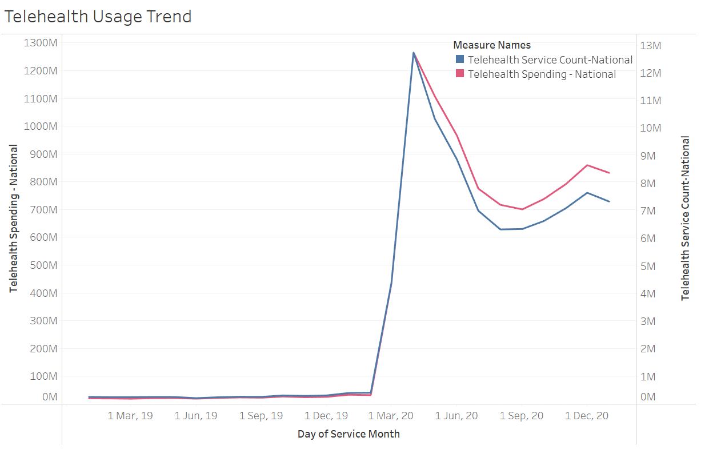
Overall: A spike increase in telehealth usage during COVID-19,
but the momentum is wearing off
To address fundamental challenges posed by the coronavirus; Medicare, states, and private insurers made multiple changes to encourage use of remote health services. Explaining the sharp increase in telehealth usage.
However, this trend is gradually decreasing and wearing off after the initial spike and expected to heavily decrease if policies are rolled back.
Figure: National Telehealth Spending over time (2018 Dec to 2020 Dec)

Slide 18
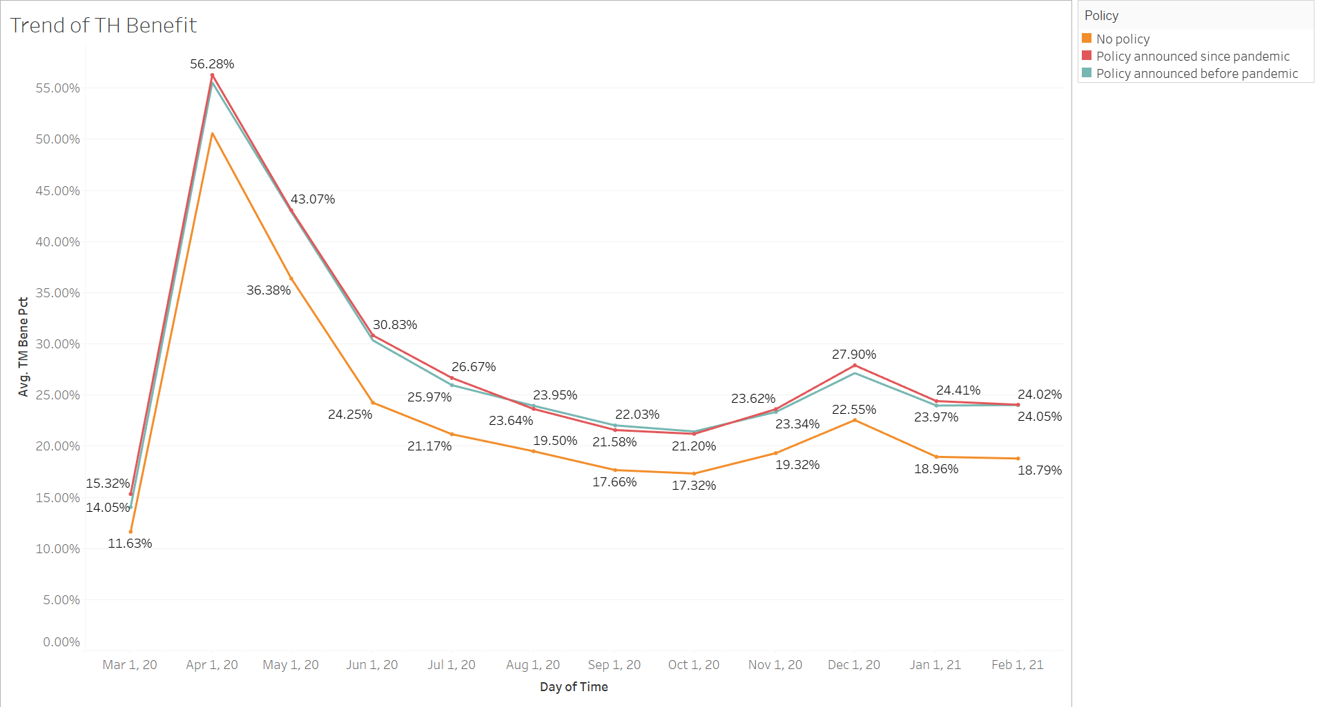
supporting policy can increase benefit from telehealth
There is a contrast between patients benefiting from telehealth from states with supporting policies, such as requiring insurers to cover telehealth services, versus those who do not have policies implemented.
States with policies have higher proportion of people who benefit from telehealth.
Notes:
Temporary changes to telehealth payment and regulation during the pandemic were not uniform between states.
This led to a significance difference in access to telehealth shown by the graph with States that have implemented policies before and since the pandemic who systematically provide higher benefits for its residence than states that did not implement clear policies.

Slide 19
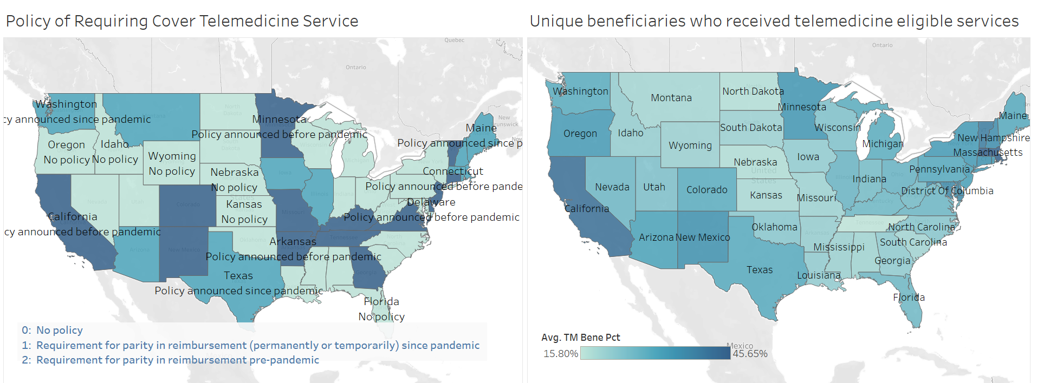
States that adopted supporting policy have more proportion of cases in benefiting from telehealth
Seven states that did not previously require coverage of telemedicine services changed their policies during the pandemic, bringing an increase in telehealth benefit
Notes:
Temporary changes to telehealth payment and regulation during the pandemic were not uniform between states.
This led to a significance difference in access to telehealth shown by the graph with States that have implemented policies before and since the pandemic who systematically provide higher benefits for its residence than states that did not implement clear policies.
https://www.commonwealthfund.org/publications/issue-briefs/2021/jun/states-actions-expand-telemedicine-access-covid-19
Medicare Telemedicine Snapshot: https://www.cms.gov/

Slide 20
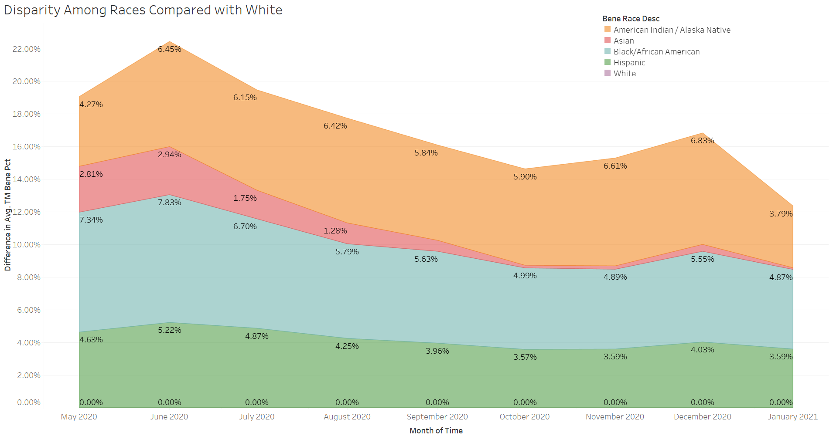
Telehealth is more proportionally used by Minorities
During the pandemic, there has been proportionally more usage of telehealth by minorities, notably American Indian and Alaska Native, African American and Hispanic groups.
Notes:
During the pandemic, there has been proportionally more usage of telehealth by minorities, notably american Indian and Alaska nnatice, african american and hispanic groups.
An indication that the usage of telehealth can more benefit those racial groups.

Slide 21
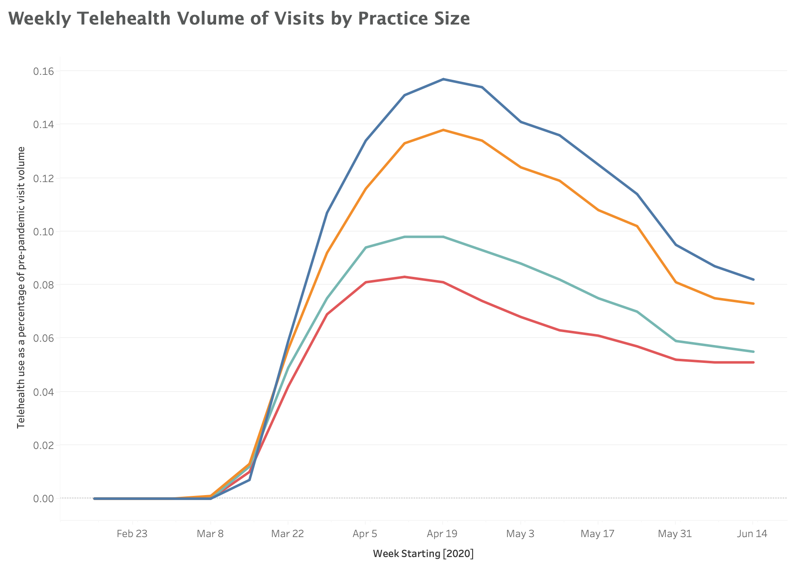
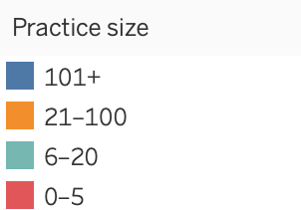
Supply: it is less likely for small clinics to utilize telehealth practice
The graph shows the fraction the telehealth as a percentage of pre-pandemic visit volume for different practice size.
We observe a clear trend where higher size practices have a tendency to use telehealth at a higher percentage.
This can be explained with infrastructure, logistics and costs associated with telehealth.
Notes:
We can observe a difference in usage of telehealth depending on the practice size. Larger practices seem to have implemented telehealth at a higher proportion compared to pre-pandemic visit volume.

Slide 22
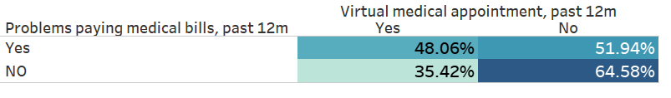
Demand: Usage of telehealth among lower income class people is also lower than those with higher income
Penetration of telehealth technology is stratified among different subgroups
The access of people belonging to the lower income class is somewhat hindered by lack or lower technology literacy or awareness of new technologies, including telehealth.

Slide 23
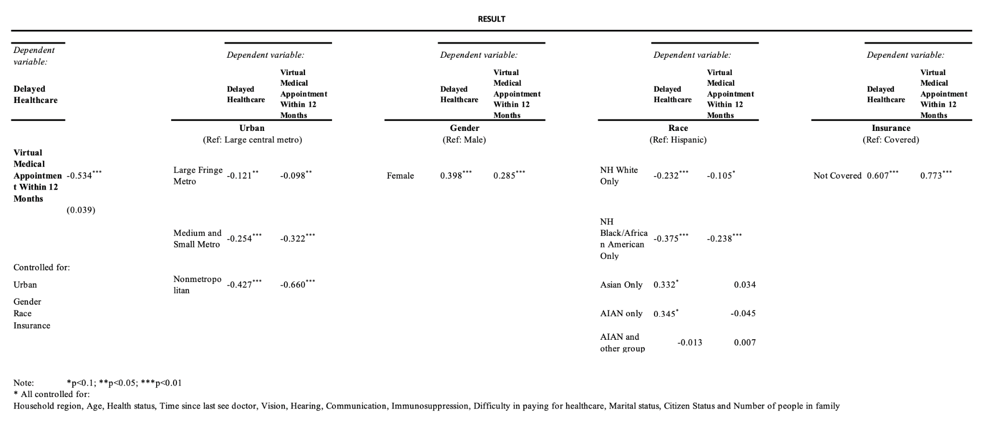
Telehealth can reduce delay and disparity in access to care
Notes:
We did 3 regression analysis:
Regress Delay to Healthcare on Usage of Telehealth
Regress Dealy to Healthcare on Disparity Factors controlling for confounding variables
Regress Usage of Telehealth on Disparity Factors controlling for confounding variables

Slide 24
Regression analysis Interpretation
Telehealth can reduce the delay of access to healthcare
The coefficient of getting virtual appointment is negatively correlated with delayed healthcare access
Disparity factors are associated with both Access to Healthcare & Telehealth Usage (i.e. all are highly statistically significant), and serving balancing effect (i.e. the significant coefficients are of the same sign). Meaning, telehealth usage can reduce the disparity for:
Area
Race
Gender
Coverage
Notes:
Telehealth can reduce the delay of access to healthcare. The coefficient of getting virtual appointment is negatively correlated with delayed healthcare access
Disparity factors are associated with both Access to Healthcare & Telehealth Usage (i.e. all are highly statistically significant), and serving balancing effect (i.e. the significant coefficients are of the same sign). Meaning, telehealth usage can reduce the disparity for geographical area, race, gender and insurance coverage.

Slide 25
Recommendation and impact
Notes:
In spite of the fact that telehealth can be the solution to disparity in access to care, we see some potential hurdles for wider adoption of telehealth practice.
We will identify three major obstacles in implementing telehealth on a larger scale with recommendations to each. Then we will estimate our impact for our recommendations.

Slide 26
Recommendations to current obstacles in wider adoption of telehealth
maintain of COverage and widen State policies on Telehealth
Private and public insurances have widen their coverage of telehealth as a direct response to the health crisis but as the pandemic fades many, including Medicare, want to roll back implemented policies. The States should push to keep telehealth covered by insurances as our analysis has clearly shown it reduces disparities and increase timely access to healthcare for minorities and rural areas. It also reduces the gap between genders and insured/uninsured individuals.
Increase Support for small and medium clinic
We have seen that small and medium size practices have less implemented telehealth overall. This is directly due to logistic, infrastructure and cost related aspect of remote health services. Support should be increased for smaller sized practices for them to augment the use of telehealth.
Support technological penetration for lower income class and rural areas
A less talked about limitation to telehealth is technology access and internet access. Lower income class are less likely to have access to the needed technology for the proper use of telehealth. Rural areas often suffer from lower internet connectivity than urban areas. The support and development of telehealth should go hand in hand with the development of internet infrastructure in rural areas and technology penetration for lower income class.

Slide 27
Impact of our recommendations:
10.5 million increase in access
Implement supporting policies
Increase number of adopted state
Increase in population who can access care through telehealth
Treat Effect = 5.23%
Adopt in larger states that covers 20% of the remaining population of the non-policy states
Increase approximately 10.5 million patients who can benefit from telehealth than forecasted unchanged figure
Numbers and rationale derive from comparison analysis, see notes below:
Notes:
We analyzed the cases and percentage of telehealth benefits between states that have supporting policies versus those who do not have supporting policies and find significance difference.
We get the average treatment effect of the supporting policy = 5.23% difference in benefit percentage
State that do not have policy = 26 states
Number of benefits in states which do not have policy = 32,723,252
Number of benefits in states which have policy = 83,044,682
Total Number of benefits in all states = 115,767,934
Change 5 states (20%) to implement the policy
Adjusted Number of Benefits:
Re-assign some non-policy state to Treatment Group, and recalculate benefit numbers proportionately.
Total Number of benefits in all states = 125,335,655
Increase in percentage of number of benefits = 8.37%
Increase in absolute figure of number of benefits = 10,567,721

Slide 28
Limitations
Group adoption & lack of previous study
Limited access to data
techniques used to collect the data
Telehealth has only been broadly used during the pandemic and longer period of usage could benefit our understanding of its impact
The data has mainly been collected by surveys and could lack proper representation of groups or might include some biases
Groups do not use telehealth technology at same rate for various reasons and the lack of previous study limits our understanding of those differences

Slide 29
THANKS!

